Slide 1
Shell Lab 2
by Ethan Hurst

Slide 2
This presentation is NOT a replacement for reading the specs! If you haven’t read them yet, GO READ THE SPECS!

Slide 3

What is exactly is a tiny shell?
It’s a program that emulate the functionality of a command terminal
It’s “tiny” because you only have to implement a few things:
start a job (run a program inside your shell)
quit – close the terminal
jobs – list all of the jobs
bg – restarts a job in background
fg – restarts a job in the foreground
ctrl-c/ctrl-z signal handlers
And there’s a lot that’s already done for you!

Slide 4
Important concepts:
(Stuff you should definitely read up on/google if you don’t understand)
Fork()/Execve()
Interrupts/Signal Handlers
Signal blocking

Slide 5
Step 1: Download shlab-handout.tar from Learning Suite
trace01.txt
trace02.txt
trace03.txt
trace04.txt
trace05.txt
trace06.txt
trace07.txt
trace08.txt
trace09.txt
trace10.txt
trace11.txt
trace12.txt
trace13.txt
trace14.txt
trace15.txt
trace16.txt
tshref
tshref.out
sdriver.pl
checktsh.pl
myspin.c
mystop.c
myspliy.c
myint.c
tsh.c
trace01.txt
trace02.txt
trace03.txt
trace04.txt
trace05.txt
trace06.txt
trace07.txt
trace08.txt
trace09.txt
trace10.txt
trace11.txt
trace12.txt
trace13.txt
trace14.txt
trace15.txt
trace16.txt
tshref
tshref.out
sdriver.pl
checktsh.pl
trace01.txt
trace02.txt
trace03.txt
trace04.txt
trace05.txt
trace06.txt
trace07.txt
trace08.txt
trace09.txt
trace10.txt
trace11.txt
trace12.txt
trace13.txt
trace14.txt
trace15.txt
trace16.txt
tshref
tshref.out
sdriver.pl
checktsh.pl
myspin.c
mystop.c
myspliy.c
myint.c
Where all of your work will be done
Auto-grader stuff, we’ll go over this later…
Mini-programs for testing functionality

Slide 6
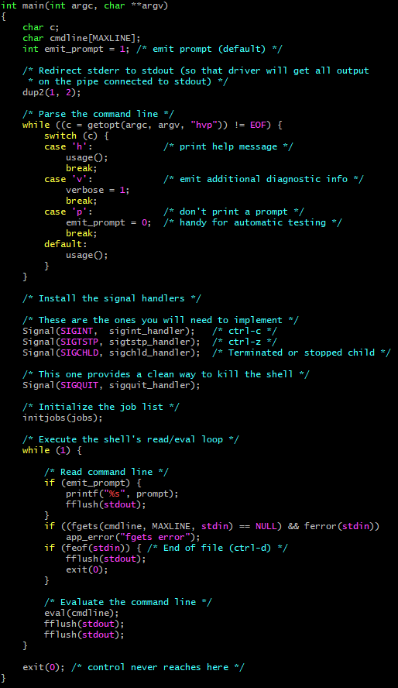
Step 2: Analyze the code you’re given
The main function is a good place to start understanding the code you’re given
The next few slides will go over the important bits

Slide 7
Step 2: Analyze the code you’re given
Notice the options available for starting the shell

Slide 8
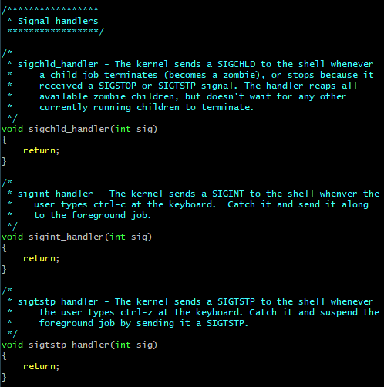
Step 2: Analyze the code you’re given
This is where the signal handlers are created
After this point, the handlers are now “listening” for their respective signals to be received

Slide 9
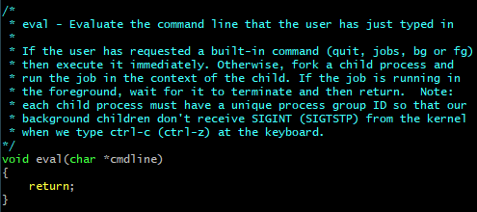
Step 2: Analyze the code you’re given
fgets() reads a string from a stream (stdin) until either:
An escape character such as ‘\n’ or ‘\d’ is reached
MAXLINE characters have been read
Once the command line has been read, eval() is called to evaluate the string
This is where the majority of the work for this project will be done

Slide 10
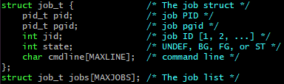
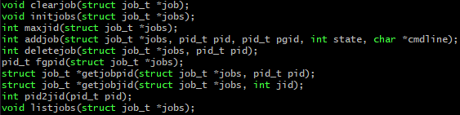
Step 2: Analyze the code you’re given
Another major part of this lab is managing the job list
Each job is meant to keep track of a process started by the shell
Sometimes a job can represent a group of processes if the initial one has split
All of functions to manage the job list have already been made for you!
All you have to know is when/where to use them

Slide 11
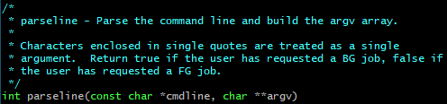
Step 3: Plan/code your eval/builtin_cmd function
In order to figure out what to do with our input, we first have to parse it into discrete arguments
parseline() is a function that does all of this for you
All it needs is a buffer to modify, I suggest something like this:
0
“Raw”
1
“input”
“Raw input from command line”
2
“from”
3
“command”
4
“line”

Slide 12
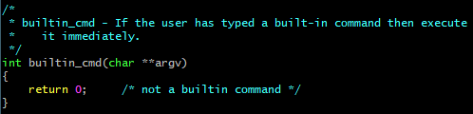

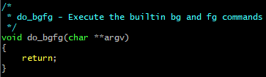
Step 3: Plan/code your eval/builtin_cmd function
Now that we have an array of discrete arguments, we can check whether or not the first element (argv[0]) is a built-in command (quit, jobs, bg, fg)
If it is a built-in command, it should be executed immediately, skipping over everything else
0
“myspin”
1
“20”
0
“quit”
0
“jobs”
0
“bg”
Don’t worry about implementing do_bgfg() right now
1
“1”

Slide 13
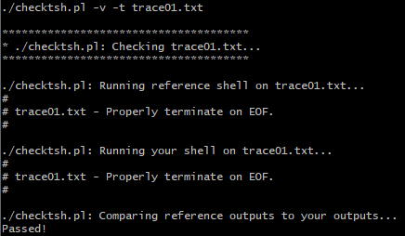
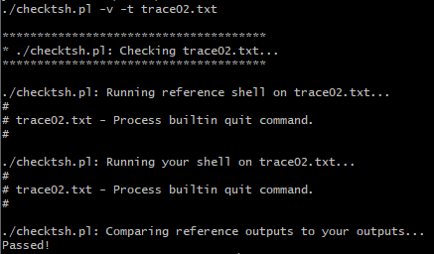
Test what you have!
With everything you have, you should be able to pass trace01 and trace02
Type make to compile your code, and then maketest01 to run trace01
Do the same for test02

Slide 14
Step 4: Finish your eval and child handler
If the input isn’t a built-in command, then we need to spawn a new process that runs the specified program
You must also add a job to the job list that keeps track of the process
Parent Process
Child Process
Make sure any sub-processes of the child all have the same group id. Otherwise we won’t be able to send signals to the child’s children
http://man7.org/linux/man-pages/man2/setpgid.2.html
fork()
execve()
Set pgid of child to its pid
Another function already made for you!
Add to job list
printf(“%s: command not found\n”, cmdline)
This part is only reached if execve() fails
These strings need to be in your code, the test driver checks for them
If the job runs in background: printf(“[%d] (%d) %s\n”, jid, pid, cmdline)
Exit the child process
Wait on the foreground process (next step)

Slide 15
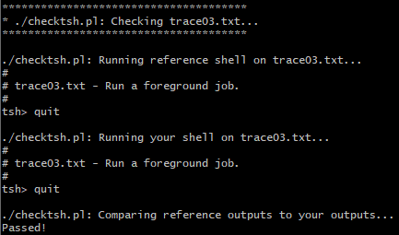
Test what you have!
Type maketest03 to run trace03
It’s not obvious, but the foreground command being run is /bin/echo

Slide 16
Step 5: Add job, waitfg(), and sigchld_handler()
At this point, you need to prevent the user from entering new commands until all of the previous one are finished
Here is an example of some commands that a user has entered
The pid’s and pgid’s are arbitrary, and will be different every time you run your program
tsh> cmd0
tsh> cmd1
tsh> cmd2
Running
Running
Running
Waiting
Running
Finished
Finished
Finished
cmd1
pid 5678
pgid 5678
Shell
pid 4398
pgid 2222
cmd0
pid 1234
pgid 1234
cmd1
pid 5678
pgid 5678
cmd0
pid 1234
pgid 1234
cmd1
pid 5678
pgid 5678
cmd2
pid 9012
pgid 9012
Shell
pid 4398
pgid 2222
cmd0
pid 1234
pgid 1234
cmd2
pid 9012
pgid 9012
Shell
pid 4398
pgid 2222
cmd2
pid 9012
pgid 9012
But how can you tell the shell to unpause after the last command if it’s running in a different process? With signals!
Right now, if you were to run multiple commands like this in your shell, all of the commands would execute at the same time.
Because the shell is still running, the user is still able to enter new commands while the previous ones are still running. This is a problem!
We need a way to pause the shell until the last command has finished running
Use presentation mode!

Slide 17
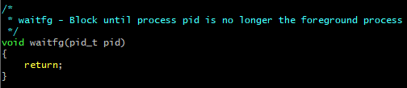
Step 5: Add job, waitfg(), and sigchld_handler()
In this step, you will be implementing waitfg() and sigchld_handler()
Immediately after your loop, you need to add a SINGLE job to the jobs list with the information from the LAST command (the state of the job comes from parseline())
addjob() has already been implemented for you
Then you need to call waitfg() and pass it the process id of the LAST command in the pipe line
Is the pid the same as the foreground pid?
No
return
Yes
Sleep for 1 second

Slide 18


Step 5: Add job, waitfg(), and sigchld_handler()
The purpose of sigchld_handler is twofold:
It reaps child processes once they’ve terminated (becoming a zombie)
It removes completed jobs from the job list
Running
Waiting
Finished
cmd1
pid 5678
pgid 1234
status alive
cmd1
pid 5678
pgid 1234
status zombie
Inside sigchld_handler(), you want to reap the child process using waitpid(): https://linux.die.net/man/3/waitpid
You’ll want to use the following options for waitpid():
pid -1 means you want to wait for any child (effectively making waitpid() behave like wait()),
WNOHANG means waitpid() will return immediately instead of blocking,
and WUNTRACED means stopped processes will be reaped
Since there may be more than one child process waiting to be reaped when sigchld_handler() is called, you need to call waitpid() in a loop until it returns something less than 0. By reaping and deleting jobs in a loop, you ensure that all zombie processes are reaped and no jobs are left unaccounted for.
Don’t forget to delete the job from the job list! This is how waitfg() will know that the current job is no longer in the foreground
What happens when 2 child processes finish at the same time? Signals behave like flags until they are handled, thus SIGCHLD will only be signaled once. This means that your shell will only be interrupted once, and only one of the processes will be reaped. This is a problem!
cmd0
pid 1234
pgid 1234
status alive
cmd0
pid 1234
pgid 1234
status zombie
Since it has been specified in main() that you want to handle all SIGCHLD signals, your shell will immediately jump to the sigchld_handler() from where ever it is, and the signal will be consumed
SIGCHLD
Shell
waitfg()
waiting on foreground job…
Shell
main()
waiting for user input…
Shell
sigchld_handler()
When a child process terminates or stops, a SIGCHLD signal is sent to the kernel
Use presentation mode!

Slide 19
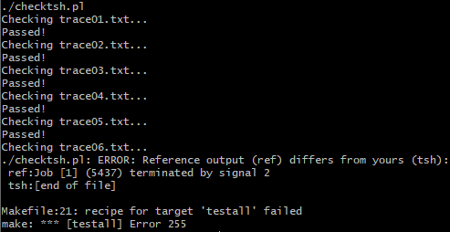
Test what you have!
Now that you can run foreground and background processes, you should be able to pass test01 through test05
Type to run all tests at once

Slide 20
Step 6: SIGINT and SIGTSTP handlers
By default, these 2 signals are sent to your shell, we want these 2 signals to be forwarded to the foreground process group
Use kill() to send signals inside your code http://man7.org/linux/man-pages/man2/kill.2.html
Make sure you send the signal to -1*pid instead of pid, that way it goes to all the processes in that group
sigint_handler
sigstp_handler
Get foreground pid
Get foreground pid
Send SIGINT to -pid
Send SIGTSTP to -pid
Again, the test driver checks that these strings are printed

Slide 21
Step 6: Handle exited/signaled/stopped
Don’t forget to handle stopped vs signaled vs exited children inside your sigchld_handler()
Use the example at the bottom of the waitpid() man page as a guide: https://linux.die.net/man/2/waitpid

Slide 22
Step 7: Block signals at critical times
The two most critical times where you DO NOT want signal interrupts to happen are:
In the command evaluation loop
When adding/deleting jobs
Slides 38 – 39 in the Chapter 8 (2) – Signals ppt on Learning Suite are very helpful here!
What we EXPECT to happen:
What COULD happen instead:
Jobs Array
Command Line
NULL
JID 1
PID 1234
CMD ./program
STATUS FG
The job is NOT removed from the jobs array (because it hasn’t been added in the first place)
The job with the corresponding PID is deleted and removed from the jobs array
tsh>
tsh> ./progam
The user can now enter a new command
A job is added to the job array with the PID of the child process executing ./progam
The shell now waits forever because the SIGCHLD for the foreground process terminating has already been sent, thus the waitfg() loop will never be interrupted
Shell
sigchld_handler()
reaping children…
Running
Waiting
Finished
Shell
main()
waiting for user input…
Shell
waitfg()
waiting for foreground job…
BEFORE a job can be add to the jobs array, ./program terminates and signals SIGCHLD
Shell
eval()
forking child processes…
The shell forks a child process to exec ./program
The shell enters the waitfg() loop until interrupted
SIGCHLD
SIGCHLD is signaled when ./program terminates
Use presentation mode!

Slide 23
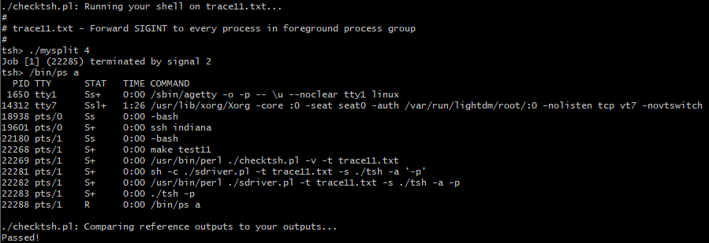
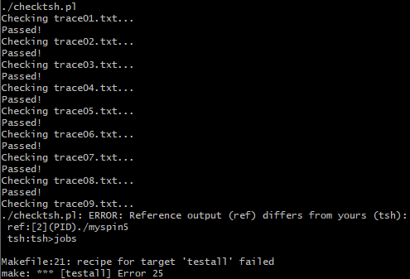
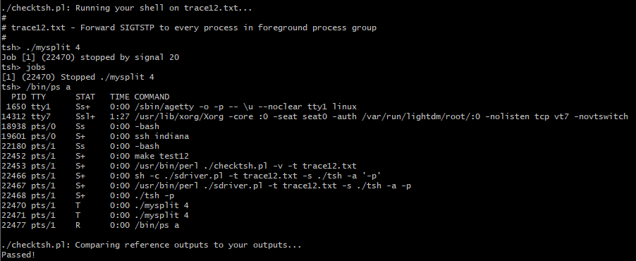
Test what you have!
With SIGINT and SIGTSTP handlers, you should be able to pass all tests up to test08 and test11/test12

Slide 24
Step 8: bg and fg commands
This will probably be the trickiest part of the lab as it requires a lot of job management and error handling
bg moves a process to the background and fg moves it to the foreground
Processes can be identified by either job id (JID) or process id (PID)
Jobs Array
Command line
JID 1
PID 1234
CMD ./myspin 20
STATUS FG
tsh> bg %3
tsh> fg %1
JID 1
PID 1234
CMD ./myspin 20
STATUS BG
tsh> fg 5678
tsh> fg %1
tsh> fg %2
This means move JOB 1 to the foreground
HINT: use the function strstr() to determine if there is a “%” character in the command line. If yes, then the rest is a JID, if no, then it is a PID. Be sure to check that there is a number after the “%” though!
This means move PROCESS 5678 to the foreground
This means move JOB 3 to the background. Remember to send a SIGCONT signal to the process in order to resume it!
REMEMBER! Only one job can be in the foreground at a time! Make sure you are calling waitfg() either before or after dobgfg() returns
JID 2
PID 5678
CMD /bin/cat
STATUS FG
JID 2
PID 5678
CMD /bin/cat
STATUS BG
Use getjobjid() to find the job struct by its JID. Remember that this function returns a pointer to the job itself (rather than a copy of the object, as in other languages), so you can directly edit the job instead of deleting then adding the job!
JID 3
PID 9012
CMD ./myspin 5
STATUS BG
JID 3
PID 9012
CMD ./myspin 5
STATUS ST
Use presentation mode!

Slide 25
Step 8: bg and fg commands
These situations require specific print statements in order to pass the auto grader
If the user doesn’t specify a PID or JID
printf("%s command requires PID or %%job id argument\n", cmd)
If the 2nd argument isn’t a number
printf("%s: argument must be a PID or %%job id\n", cmd)
If the PID or JID doesn’t exist
printf("(%d): No such process\n", pid)
printf("(%d): No such job\n", jid)
If the process was started in the background
printf("[%d] (%d) %s\n", jid, pid, cmdline)

Slide 26
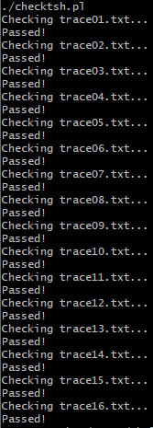
Test what you have!
That’s everything! If you did everything right you should be able to pass all tests
Submit just your tsh.c file to learning suite

